Slide 1
The Federal Resource Management and Ecosystem Services Guidebook
ECOLOGICAL ASSESSMENT:
MEANS-ENDS DIAGRAMS
ACES Workshop 2014
Christy Ihlo, MEM
Research Assistant, Ecosystem Services Program
Nicholas Institute for Environmental
Policy Solutions
Duke University
Notes:
(NOTE: these slides are much larger than the standard PowerPoint slide. They will project fine during a presentation, but that is why the font sizes are so much larger than typical.)
This presentation is one of a series given at an ACES workshop, December 8 2014 titled “Methods for Incorporating Ecosystem Services into Planning and Decision-Making” led by Lydia Olander (Nicholas Institute for Environmental Policy Solutions at Duke University and National Ecosystem Services Partnership) and Dean Urban (Nicholas School of the Environment at Duke University). This workshop discussed methods for conducting ecosystem services assessments as detailed in the Federal Resource Management and Ecosystem Services Guidebook. This presentation was created and presented by Christy Ihlo and focuses on using means-ends diagrams to assess changes in the provision of ecosystem services.

Slide 2
Means-Ends Diagrams
Linking Management, Project, or Policy Choices to Ecosystem Service Provision
Christy M. Ihlo, Nicholas Institute for Environmental Policy Solutions at Duke University
Notes:
Moving on to the ecological analysis part of the assessment, we’ll be talking and then experimenting with some means-ends diagrams

Slide 3
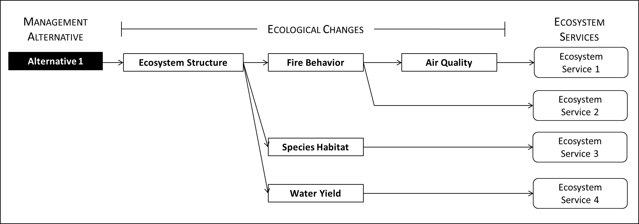
What Are Means-Ends Diagrams?
Visual mapping tools
AKA path models, influence diagrams, causal chains, and belief networks
In the FRMES guidebook, they assess how management, project, or policy options change the provision of ecosystem services through ecological pathways
Notes:
First, what are these diagrams? Many of you are likely already familiar with them in some form. They are visual mapping tools that can show the connections between things.
They go by a number of different names and can be used in a number of different contexts.
In this guidebook, means-ends diagrams are used to provide a systematic way to visually assess how management options will change the biophysical landscape and thus change the provision of ecosystem services.

Slide 4
How Do Means-Ends Fit Into the Framework?
Scoping
The process of identifying management objectives in terms of ecosystem services based on assessment of ecological and social data on current conditions and past management outcomes
Assessment and Analysis
The process of assessing management/project options in terms of changes in the supply of ecosystem services and the benefits they provide to people using both ecological and social science methods
Decision
The process of combining information on the decision context with analytical results to make a choice
Reaction
The process of monitoring and evaluating actions and outcomes in terms of ecosystem services to inform adjustments or updates in management
Management alternatives or project options
Alternatives matrix comparing options
Set of desired outcomes and key indicators
Data on actions and outcomes
Notes:
As a reminder – where are we in the assessment framework?
Means-ends diagrams are part of the ecological analysis presented in this guidebook’s assessment framework.
They yield a selection of ecological indicators that are relevant to things people care about. This set of indicators can be used in social analysis.
Additionally, means-ends diagrams can be an effective communications tool with stakeholders, visually showing how management choices influence the things stakeholders value about ecosystems. The diagrams can also help stakeholders understand potential tradeoffs between competing values or interests.

Slide 5
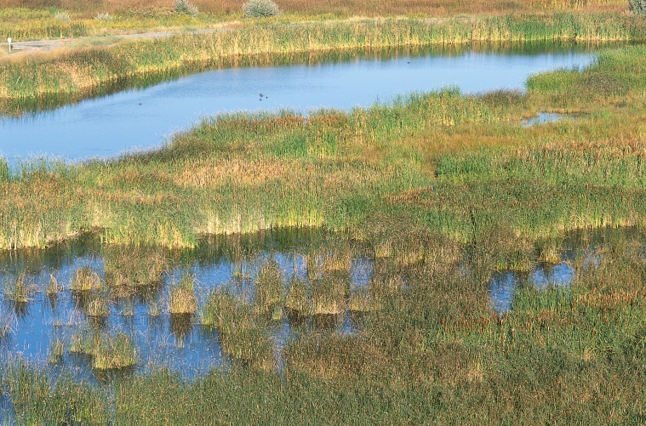
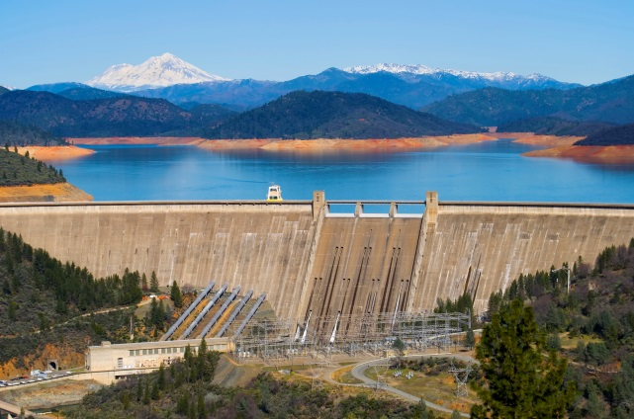
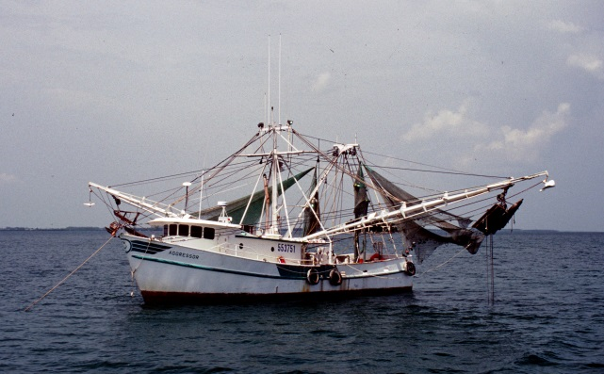
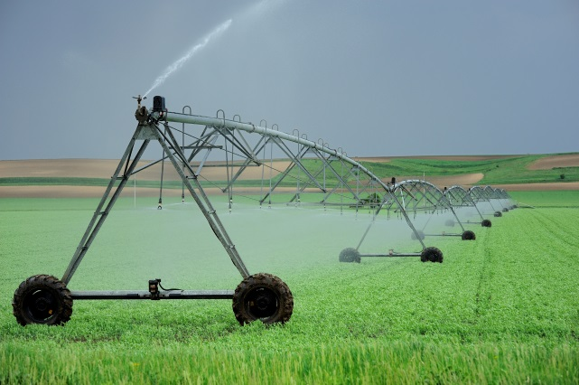
What Are the Means and the Ends?
Means: management, project, or policy choices (at various locations)
Ends: what people care about (ecosystem services)
Notes:
The means are the suite of management, project, or policy choices that are under consideration. These can be individual actions or treatments at varying locations, combinations of actions in management scenarios or management plans, different project options (such as funding a wetland restoration in Florida versus Minnesota), or even different policy options. Policy options are slighting different – what is evaluated in the diagrams are the actions the policy implies – a policy that would create incentives for protecting riparian zones would be evaluated in terms of the changes to riparian zones.
The ends are the things people care about in a particular ecosystem.
Both are identified through the scoping process.

Slide 6
How Are These Diagrams Useful?
Identify the cascade of ecological interactions caused by a management, project, or policy
Identify indicators to measure those changes
Provide a visual representation of benefits and tradeoffs
Show analysis steps and data/models needed
Highlight what is known and not known integrating data and models
Notes:
Before we jump into creating them – let spend just a couple of minutes on why these things are useful to ecosystem services assessments. Why go through the effort?
First the outline the cascade of ecological interactions caused by a given management choice and how those interactions and effects cascade through the system to affect the provision of ecosystem services – which are what matters to people – this includes biophysical structures, processes, and conditions.
They also identify indicators that can measure those changes – some of those indicators can be used to bridge the gap between ecological and social analysis, which we will discuss in more detail later.
This diagrams also provide a visual representation of both benefits and tradeoffs, which can be beneficial not only to managers, but also in conversations with stakeholders.
If quantified, these diagrams create an analysis map of sorts – showing the date and models that are needed.
The process of creating these diagrams can highlight what is known and not known, identifying the data and modeling capacity needed to quantify both the ecological changes and changes in the provision of services.

Slide 7
How Do They Enable Comparisons?
Alternative 1
Ecological Changes
Ecosystem
Service 1
Ecosystem
Service 2
Ecosystem
Service 3
Ecosystem Service | Alternative 1 | Alternative 2
Service 1 | Increase | Decrease
Service 2 | Decrease | Increase
Service 3 | Increase | Increase
Service 4 | Increase | Decrease
Service 5 | Decrease | Decrease
Ecosystem
Service 4
Ecosystem
Service 5
Alternative 2
Ecological Changes
Ecosystem
Service 1
Ecosystem
Service 2
Ecosystem
Service 3
But what about space? Isn’t spatial context important?
Ecosystem
Service 4
Ecosystem
Service 5
Notes:
We recommend creating one diagram for each management, project, or policy alternative and then comparing the results using an alternatives matrix.
In the very generic diagrams and matrix above, yellow denotes a decrease in a service and green an increase. The matrix could just as easily be filled with +/-, arrows, or values (if quantified).
[CLICK] Spatial context plays a very important role in many decision processes.

Slide 8
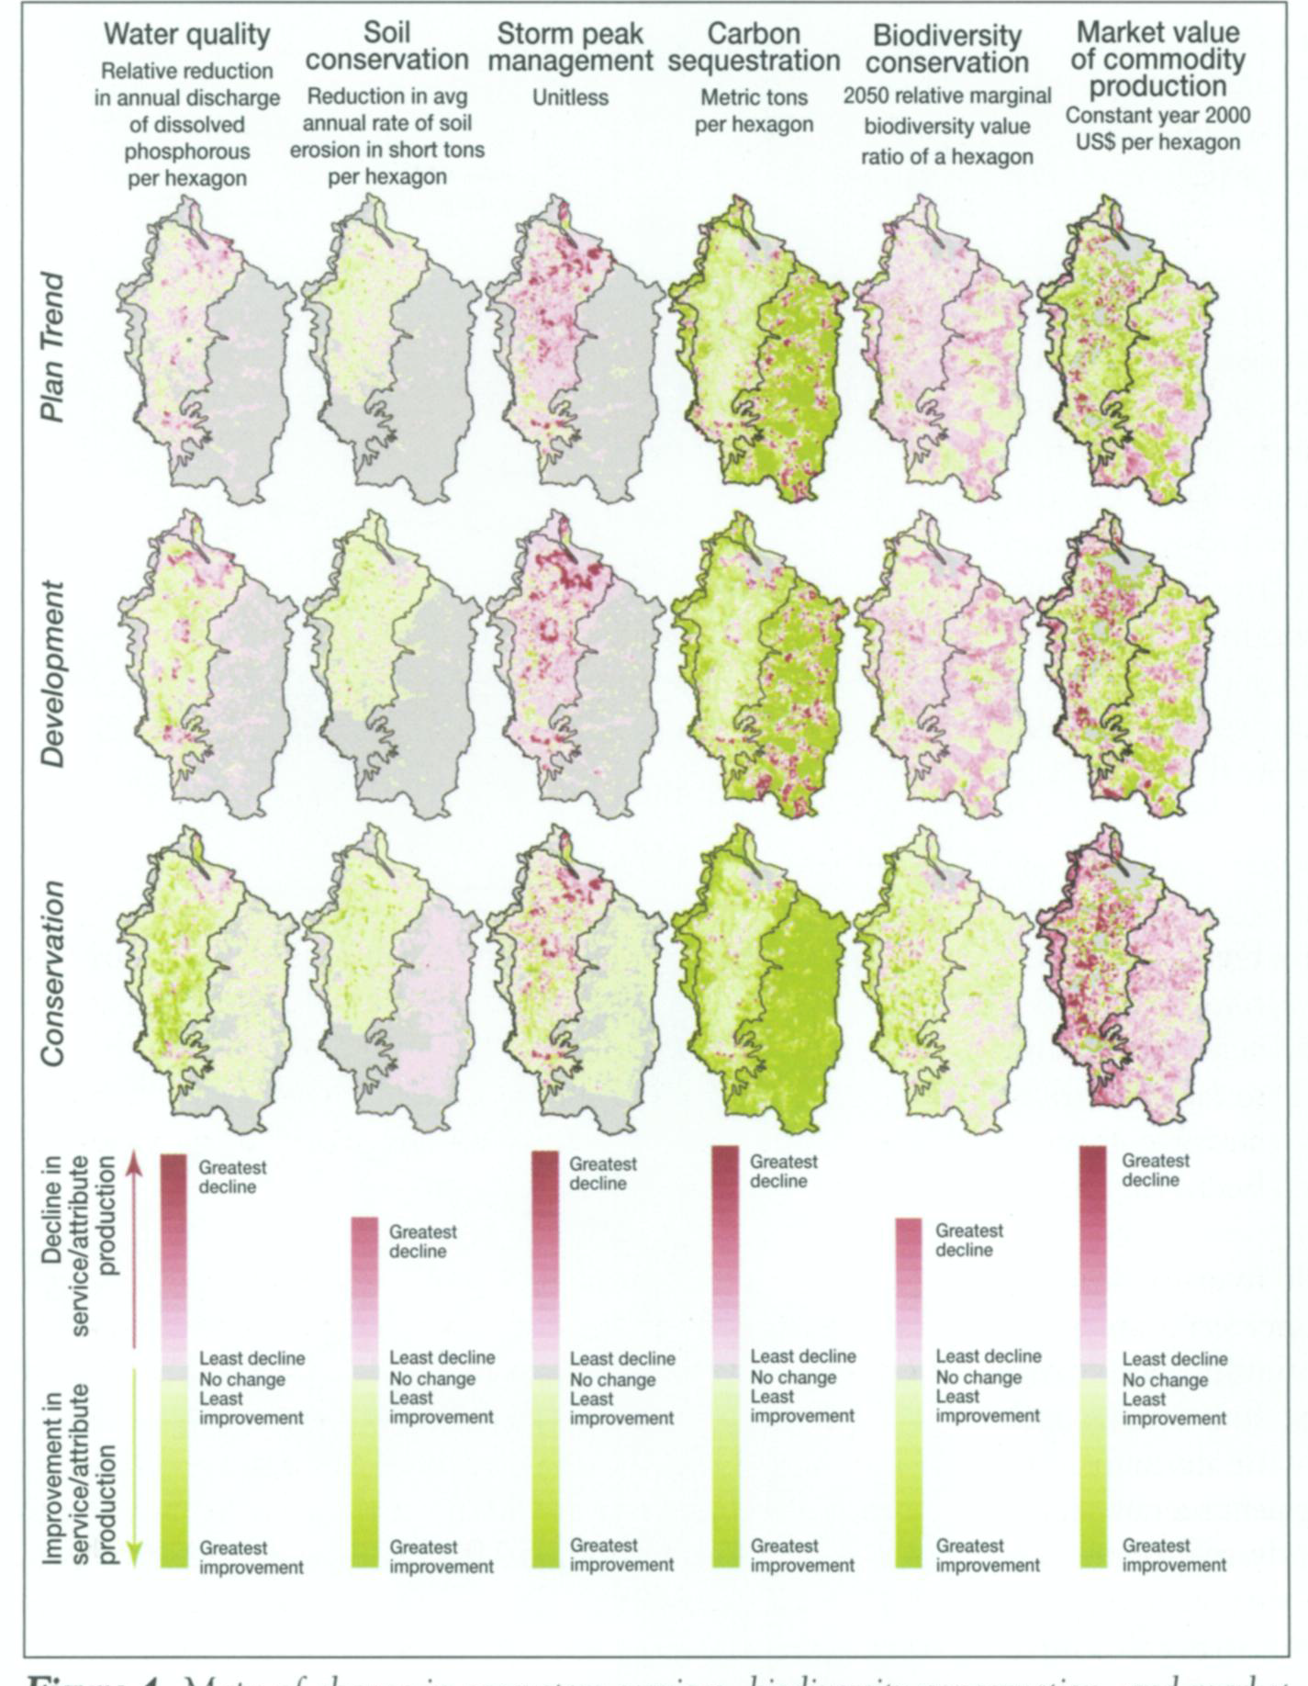
Considering Space
Nelson et al. 2009
Notes:
Means-ends diagrams can incorporate space in two ways:
By comparing alternatives in different locations
And also many models that would be used to quantify ecological changes can incorporate geospatial information.
These model outputs can demonstrate how the provision of services may vary depending on the management, project, or policy choice.
Shown here is a figure from a paper by Nelson et al. (Erik Nelson, Modeling Multiple Ecosystem Services, Biodiversity Conservation, Commodity Production, and Tradeoffs at Landscape Scales) that shows how the spatial provision of different services is expected to change based on three different scenarios.

Slide 9
Creating Means-Ends Diagrams
Notes:
Now that we’ve got a little background on what these diagrams are and why they are useful, we’re going to walk through creating one and then you’ll have the chance to work with your table and create another one a bit later.
Creating these diagrams is an iterative process that is difficult to describe without doing it, so we are going to walk through a hypothetical example.
They require expertise – and not only ecological or biophysical expertise, but this process can benefit from the engagement of social scientists as well. Social scientists may be able to help identify indicators that will be easier to use in social preference analysis (the next step of the assessment process).
An important caveat here is that is demo is not intended to be comprehensive and we’re not implying that the ecological structures, conditions, and indicators are the best or only ones.

Slide 10
Hypothetical Example
Task: reduce risk of catastrophic wildfire to urban areas and improve air quality
 | POTENTIAL MANAGEMENT ALTERNATIVES
 | ALT. 1 | ALT. 2 | ALT. 3 | ALT. 4 | ALT. 5 | ALT. 6
 | Mechanical Thinning | Prescribed Burning | Mechanical Thinning | Prescribed Burning | Chemical Cheatgrass Removal | Chemical Cheatgrass Removal
 | (Site A - Lowland) | (Site A - Lowland) | (Site B - Upland) | (Site B - Upland) | (Site C) | (Site D)
Fuel conditions result in a low threat to community | ü | ü | ü | ü
Visibility and healthy air maintained | ü | ü | ü | ü | ü | ü
Riparian areas resilient to fire | ü | ü
Hunting/wildlife watching opportunities improved | ü | ü
Hiking/camping opportunities maintained | ü | ü | ü
Timber harvest sustained | ü |  | ü
Habitats/species protected | ü | ü | ü | ü | ü | ü
Notes:
In this hypothetical scenario, which many of you are probably familiar with, managers have been tasked with reducing the risk of catastrophic wildfire to protect life and property and improve air quality. So they identified a some ecological conditions that could achieve this goal. However, they know many of their typical actions have the potential to impact other services provided to the community, so they engaged community members to learn what they value about the forest.

Slide 11
Hypothetical Example
Task: reduce risk of catastrophic wildfire to urban areas and improve air quality
 | POTENTIAL MANAGEMENT ALTERNATIVES
 | ALT. 1 | ALT. 2 | ALT. 3 | ALT. 4 | ALT. 5 | ALT. 6
 | Mechanical Thinning | Prescribed Burning | Mechanical Thinning | Prescribed Burning | Chemical Cheatgrass Removal | Chemical Cheatgrass Removal
 | (Site A - Lowland) | (Site A - Lowland) | (Site B - Upland) | (Site B - Upland) | (Site C) | (Site D)
Fuel conditions result in a low threat to community | ü | ü | ü | ü
Visibility and healthy air maintained | ü | ü | ü | ü | ü | ü
Riparian areas resilient to fire | ü | ü
Hunting/wildlife watching opportunities improved | ü | ü
Hiking/camping opportunities maintained | ü | ü | ü
Timber harvest sustained | ü |  | ü
Habitats/species protected | ü | ü | ü | ü | ü | ü
Notes:
The community identified a number of additional ecosystem services they care about. And then managers were able to use these conditions and services to identify a suite of management alternatives.

Slide 12
Hypothetical Example
Task: reduce risk of catastrophic wildfire to urban areas and improve air quality
 | POTENTIAL MANAGEMENT ALTERNATIVES
 | ALT. 1 | ALT. 2 | ALT. 3 | ALT. 4 | ALT. 5 | ALT. 6
 | Mechanical Thinning | Prescribed Burning | Mechanical Thinning | Prescribed Burning | Chemical Cheatgrass Removal | Chemical Cheatgrass Removal
 | (Site A - Lowland) | (Site A - Lowland) | (Site B - Upland) | (Site B - Upland) | (Site C) | (Site D)
Fuel conditions result in a low threat to community | ü | ü | ü | ü
Visibility and healthy air maintained | ü | ü | ü | ü | ü | ü
Riparian areas resilient to fire | ü | ü
Hunting/wildlife watching opportunities improved | ü | ü
Hiking/camping opportunities maintained | ü | ü | ü
Timber harvest sustained | ü |  | ü
Habitats/species protected | ü | ü | ü | ü | ü | ü
Notes:
The identified three different activities in four different sites. In order to do an ecosystem services assessment, you may think it is necessary to evaluate all of these options (and in reality, there would probably be more) which could be a significant undertaking. However, that isn’t always necessary and the ecological assessment starts a winnowing process that only carries those alternatives through the assessment that will likely have an impact on ecosystem services.

Slide 13
Hypothetical Example
Task: reduce risk of catastrophic wildfire to urban areas and improve air quality
 | POTENTIAL MANAGEMENT ALTERNATIVES
 | ALT. 1 | ALT. 2 | ALT. 3 | ALT. 4 | ALT. 5 | ALT. 6
 | Mechanical Thinning | Prescribed Burning | Mechanical Thinning | Prescribed Burning | Chemical Cheatgrass Removal | Chemical Cheatgrass Removal
 | (Site A - Lowland) | (Site A - Lowland) | (Site B - Upland) | (Site B - Upland) | (Site C) | (Site D)
Fuel conditions result in a low threat to community | ü | ü | ü | ü
Visibility and healthy air maintained | ü | ü | ü | ü | ü | ü
Riparian areas resilient to fire | ü | ü
Hunting/wildlife watching opportunities improved | ü | ü
Hiking/camping opportunities maintained | ü | ü | ü
Timber harvest sustained | ü |  | ü
Habitats/species protected | ü | ü | ü | ü | ü | ü
Notes:
A quick table to assess which alternatives have the capacity to improve the desired conditions and services can highlight which alternatives are the most promising.

Slide 14
Hypothetical Example
Task: reduce risk of catastrophic wildfire to urban areas and improve air quality
 | POTENTIAL MANAGEMENT ALTERNATIVES
 | ALT. 1 | ALT. 2 | ALT. 3 | ALT. 4 | ALT. 5 | ALT. 6
 | Mechanical Thinning | Prescribed Burning | Mechanical Thinning | Prescribed Burning | Chemical Cheatgrass Removal | Chemical Cheatgrass Removal
 | (Site A - Lowland) | (Site A - Lowland) | (Site B - Upland) | (Site B - Upland) | (Site C) | (Site D)
Fuel conditions result in a low threat to community | ü | ü | ü | ü
Visibility and healthy air maintained | ü | ü | ü | ü | ü | ü
Riparian areas resilient to fire | ü | ü
Hunting/wildlife watching opportunities improved | ü | ü
Hiking/camping opportunities maintained | ü | ü | ü
Timber harvest sustained | ü |  | ü
Habitats/species protected | ü | ü | ü | ü | ü | ü
Notes:
In this scenario, the three alternatives on the right have the possibility of improving the fewest outcomes and services, so they can be eliminated. Now, we’ll walk through creating a means-ends diagram for one of these alternatives, mechanical thinning at Site A.

Slide 15
Building a Means-Ends Diagram
Management
Alternative
Ecological Changes
Ecosystem
Services
Mechanical Thinning
(Site A – Lowland)
Respiratory Health
Commuter Visibility
Reduction of Fire Risk
Timber
Hiking
Camping
Recreational Hunting
Wildlife Watching
Biodiversity Existence
Increase
Decrease
Increase or Decrease
Notes:
When creating a means-ends diagram, the first step is to put your alternative on the far left, and all your services or outcomes on the far right. But you shouldn’t be limited to the services already identified. One of the benefits of these diagrams is that they can reveal additional services that may be affected by a change.

Slide 16
Building a Means-Ends Diagram
Management
Alternative
Ecological Changes
Ecosystem
Services
Mechanical Thinning
(Site A – Lowland)
Fire
Air Quality
Respiratory Health
Commuter Visibility
Reduction of Fire Risk
Timber
Hiking
Camping
Recreational Hunting
Wildlife Watching
Biodiversity Existence
Increase
Decrease
Increase or Decrease
Notes:
Then you can start to think about how your alternative affects the outcomes. In this case, the most obvious impact of mechanical thinning is on fire risk and also air quality.

Slide 17
Building a Means-Ends Diagram
Management
Alternative
Ecological Changes
Ecosystem
Services
Mechanical Thinning
(Site A – Lowland)
Forest Structure
Fire
Air Quality
Respiratory Health
Commuter Visibility
Reduction of Fire Risk
Timber
Hiking
Camping
Recreational Hunting
Wildlife Watching
Biodiversity Existence
Increase
Decrease
Increase or Decrease
Notes:
Fire risk and air quality are altered because of an underlying change in forest structure, and thus those elements are connected through forest structure.

Slide 18
Building a Means-Ends Diagram
Management
Alternative
Ecological Changes
Ecosystem
Services
Mechanical Thinning
(Site A – Lowland)
Forest Structure
Fire
Air Quality
Understory Density
Fire Severity
(% Mortality)
Particulates
Respiratory Health
Horizontal Connectivity
Fire Return Interval
Visibility
Commuter Visibility
Total Forest Area
Fire Burnt Area
Reduction of Fire Risk
Timber
Hiking
Camping
Recreational Hunting
Wildlife Watching
Biodiversity Existence
Increase
Decrease
Increase or Decrease
Notes:
Now that the initial chain of impacts is identified, you can start to think about indicators that can measure those ecological changes. Again, the ones shown here are only examples. Ideally, these would be linked to already existing data. As I mentioned once already, the guidebook contains some information on selecting indicators.
Not only can these diagrams show the components that are connected, they can also be color-coded to show expected directional changes. In this case, we’ve used colors to show increases and decreases but it is important to realize that increase does not equal positive and that you could use positive and negative instead – this may be harder if you are going to quantify the diagrams (discussed in a bit), but could be easier in discussions with stakeholders.
You could also experiment with change the weights of styles of the arrows to indicate magnitude of change or temporary vs long-term impacts.
Uncertainly can be simply acknowledged with text.

Slide 19
Building a Means-Ends Diagram
Management
Alternative
Ecological Changes
Ecosystem
Services
Mechanical Thinning
(Site A – Lowland)
Forest Structure
Fire
Air Quality
Understory Density
Fire Severity
(% Mortality)
Particulates
Respiratory Health
Horizontal Connectivity
Fire Return Interval
Visibility
Commuter Visibility
Total Forest Area
Fire Burnt Area
Reduction of Fire Risk
Timber
Hiking
Camping
Recreational Hunting
Terr. Sp. Habitats
Terr. Sp. Pop.
Habitat Suitability
Population Estimates
Wildlife Watching
Contiguous Habitat Area
Biodiversity Existence
Increase
Decrease
Increase or Decrease
Notes:
Changing the understory density or horizontal connectivity may also affect species habitat, which could ultimately affect services such as hunting, wildlife watching, and biodiversity existence.
Species indicators are colored purple here because some species may benefit from changes caused by mechanical thinning but others may not.
In reality, you would likely have boxes for different species habitats – using key species that are important either from a regulatory standpoint (at-risk species) or from a stakeholder standpoint (hunt-able species, or charismatic species).

Slide 20
Building a Means-Ends Diagram
Management
Alternative
Ecological Changes
Ecosystem
Services
Mechanical Thinning
(Site A – Lowland)
Forest Structure
Fire
Air Quality
Understory Density
Fire Severity
(% Mortality)
Particulates
Respiratory Health
Horizontal Connectivity
Fire Return Interval
Visibility
Commuter Visibility
Total Forest Area
Fire Burnt Area
Reduction of Fire Risk
Timber
Pests/Pathogens
Hiking
Outbreak Susceptibility
Camping
Outbreak Area
Outbreak Intensity
Recreational Hunting
Forest Floor Structure
Terr. Sp. Habitats
Terr. Sp. Pop.
Habitat Suitability
Population Estimates
Wildlife Watching
Soil Compaction
Contiguous Habitat Area
Litter Depth
Biodiversity Existence
Increase
Decrease
Increase or Decrease
Notes:
Species habitats may also be influenced by other factors. Changes in forest structure may reduce susceptibility to pest and pathogen outbreaks, which can benefit species habitats.
Mechanical thinning may also affect forest floor structure by compacting the soil and decreasing litter depth.

Slide 21
Building a Means-Ends Diagram
Management
Alternative
Ecological Changes
Ecosystem
Services
Mechanical Thinning
(Site A – Lowland)
Forest Structure
Fire
Air Quality
Understory Density
Fire Severity
(% Mortality)
Particulates
Respiratory Health
Horizontal Connectivity
Fire Return Interval
Visibility
Commuter Visibility
Total Forest Area
Fire Burnt Area
Reduction of Fire Risk
Timber
Pests/Pathogens
Hiking
Outbreak Susceptibility
Camping
Outbreak Area
Outbreak Intensity
Recreational Hunting
Forest Floor Structure
Terr. Sp. Habitats
Terr. Sp. Pop.
Habitat Suitability
Population Estimates
Wildlife Watching
Soil Compaction
Contiguous Habitat Area
Litter Depth
Biodiversity Existence
Increase
Decrease
Erosion Potential
Water Quality
Aq. Sp. Habitat
Fish Populations
Increase or Decrease
Runoff
Sediment Load
Habitat Suitability
Population Estimates
Fishing
Notes:
Changes in forest floor structure suggests possible changes to erosion, water quality, and ultimately fishing – fishing was not in the original list of services identified, which we’ve denoted here with the hashed symbology. It is also a tradeoff, but it could decrease. However, these changes would likely be temporary, so managers would have to decide if this tradeoff is actually important to the analysis (or perhaps fishing isn’t an activity in this area, in which that case, it doesn’t matter). But the point is, that you’ve now made a conscious, and hopefully defensible, decision not to include it.

Slide 22
Building a Means-Ends Diagram
Management
Alternative
Ecological Changes
Ecosystem
Services
Mechanical Thinning
(Site A – Lowland)
Forest Structure
Fire
Air Quality
Understory Density
Fire Severity
(% Mortality)
Particulates
Respiratory Health
Horizontal Connectivity
Fire Return Interval
Visibility
Commuter Visibility
Total Forest Area
Fire Burnt Area
Carbon
Reduction of Fire Risk
Standing Carbon Stocks
Rate of Carbon Seq.
Climate Stability
Carbon Seq. in Forest Products
Timber
Pests/Pathogens
Hiking
Outbreak Susceptibility
Camping
Outbreak Area
Outbreak Intensity
Recreational Hunting
Forest Floor Structure
Terr. Sp. Habitats
Terr. Sp. Pop.
Habitat Suitability
Population Estimates
Wildlife Watching
Soil Compaction
Contiguous Habitat Area
Litter Depth
Biodiversity Existence
Water Yield
Water Volume
Boating
Increase
Water Timing (Consistency)
Decrease
Erosion Potential
Water Quality
Aq. Sp. Habitat
Fish Populations
Increase or Decrease
Runoff
Sediment Load
Habitat Suitability
Population Estimates
Fishing
Notes:
Thinning may reduce leaf area and thus transpiration, which may affect increase water volume and also impact the consistency of water delivery – which could impact boating opportunities.
Finally, thinning may also decrease standing carbon stocks; however, it will likely increase sequestration rates. Some carbon may also be permanently sequestered in forest products.
One important note, when you start adding additional services, this may mean that you need to engage additional stakeholders in the process.

Slide 23
Building a Means-Ends Diagram
Management
Alternative
Ecological Changes
Ecosystem
Services
Mechanical Thinning
(Site A – Lowland)
Forest Structure
Fire
Air Quality
Understory Density
Fire Severity
(% Mortality)
Particulates
Respiratory Health
Horizontal Connectivity
Fire Return Interval
Visibility
Commuter Visibility
Total Forest Area
Fire Burnt Area
Carbon
Reduction of Fire Risk
Standing Carbon Stocks
Rate of Carbon Seq.
Climate Stability
Carbon Seq. in Forest Products
Timber
Pests/Pathogens
Hiking
Outbreak Susceptibility
Camping
Outbreak Area
Outbreak Intensity
Recreational Hunting
Forest Floor Structure
Terr. Sp. Habitats
Terr. Sp. Pop.
Habitat Suitability
Population Estimates
Wildlife Watching
Soil Compaction
Contiguous Habitat Area
Litter Depth
Biodiversity Existence
Water Yield
Water Volume
Boating
Increase
Water Timing (Consistency)
Decrease
Erosion Potential
Water Quality
Aq. Sp. Habitat
Fish Populations
Increase or Decrease
Runoff
Sediment Load
Habitat Suitability
Population Estimates
Fishing
Notes:
Lastly, there are still a few services to consider. A thinned understory will enhance the growth of larger, merchantable trees, and hiking and camping can be impacted by the total forest area.
This diagram is now complete – at least for demonstration purposes. It is QUALITATIVE– in qualitative diagrams, the arrows represent biophysical and ecological models that describe the direction and possibly relative magnitude of potential changes resulting from the alternative. These models can also be quantitative.
Qualitative diagrams can serve as another step in the winnowing process – you can use qualitative diagrams to understand which alternatives would be most effective in capturing the desired conditions and services and then these top choices can be quantified.

Slide 24
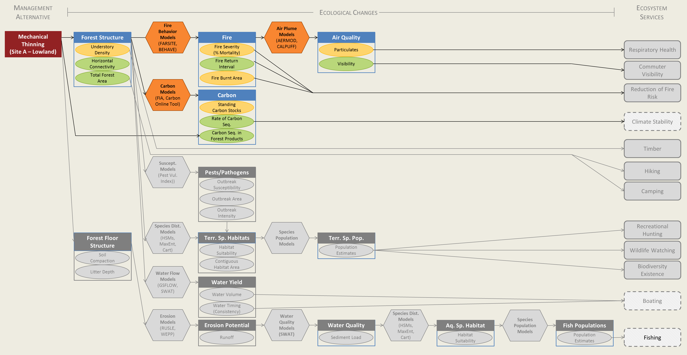
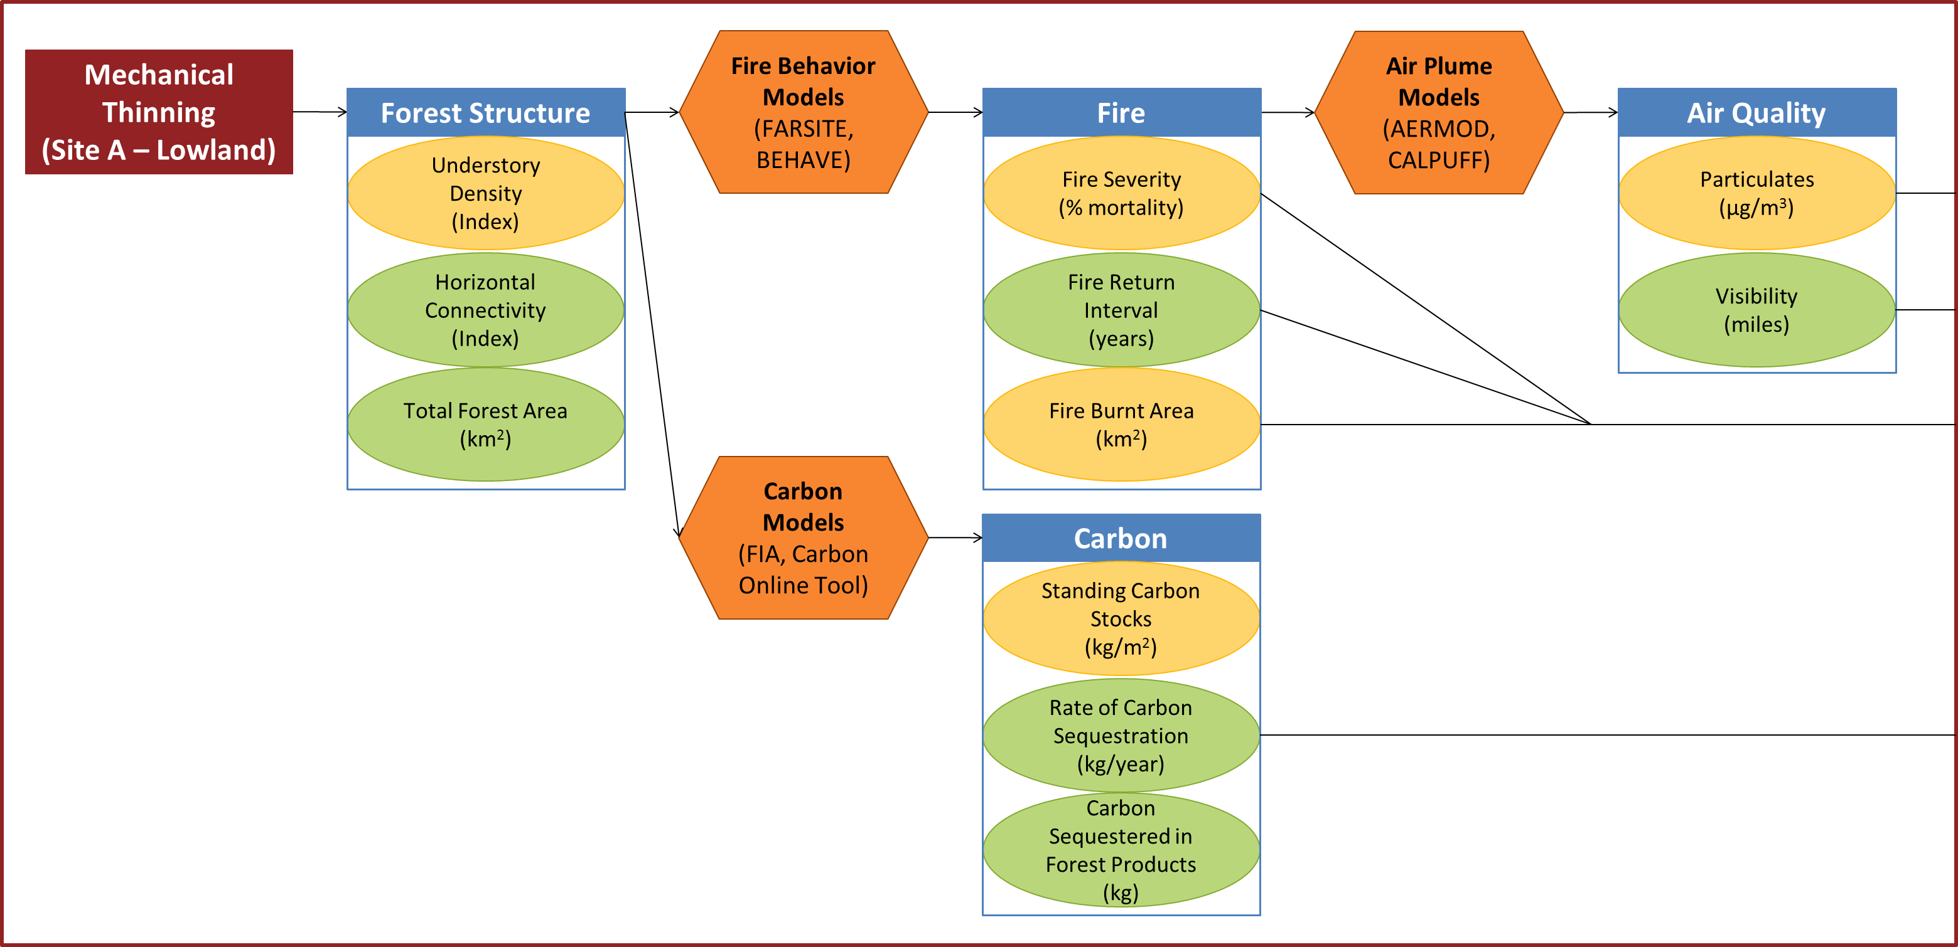
Qualitative versus Quantitative Diagrams
Notes:
Quantitative diagrams detail the direction and magnitude of ecological changes predicted by the ecological models. Many models are also capable of incorporating spatial information and can capture spatial variability in ecosystem/ecological response to management.
Importantly, given that ecology is context-dependent in space and time, using models (production functions) without local data will introduce uncertainty into the model results. Expert judgment may be substituted in the absence of models to quantify changes.
Once quantified through either modeling or expert judgment, changes in indicators can then be described in terms of numbers and units, rather than words.
The use of specific models will have a direct bearing on the selection of empirical indicators embedded in the means-end diagram because particular models require model-specific parameters as input.
Shown here is a subset of the full diagram (showing the large one is impossible on a slide) – with some suggestions for the types of models and units that could be used. These are not the only models available – these are just examples.
One thing we’ve not shown is that you can combine indicators to form indices in these diagrams, but predicting how indices from multiple indicators will respond to management can be difficult. The guidebook includes some information on that.
So we’ve shown that these diagrams can include lots of things – the components that are altered, ways to measure them, symbology that captures magnitude of change or temporary versus long term impacts, and even uncertainty.
One thing they do not include is external drivers; they are left out because they cannot be influenced by management. However, external drivers should be incorporated into models as appropriate.

Slide 25
Selecting Indicators for Social Analysis
Management
Alternative
Ecological Changes
Ecosystem
Services
Mechanical Thinning
(Site A – Lowland)
Forest Structure
Fire
Air Quality
Understory Density
Fire Severity
(% Mortality)
Particulates
Respiratory Health
Horizontal Connectivity
Fire Return Interval
Visibility
Commuter Visibility
Total Forest Area
Fire Burnt Area
Carbon
Reduction of Fire Risk
Standing Carbon Stocks
Rate of Carbon Seq.
Climate Stability
Carbon Seq. in Forest Products
Timber
Pests/Pathogens
Hiking
Outbreak Susceptibility
Camping
Outbreak Area
Outbreak Intensity
Recreational Hunting
Forest Floor Structure
Terr. Sp. Habitats
Terr. Sp. Pop.
Habitat Suitability
Population Estimates
Wildlife Watching
Soil Compaction
Contiguous Habitat Area
Litter Depth
Biodiversity Existence
Water Yield
Water Volume
Boating
Increase
Water Timing (Consistency)
Decrease
Erosion Potential
Water Quality
Aq. Sp. Habitat
Fish Populations
Increase or Decrease
Runoff
Sediment Load
Habitat Suitability
Population Estimates
Fishing
Notes:
Means-ends diagrams yield a suite of ecological indicators. Some of these indicators are simply interesting because they mediate ecological processes; but some are especially relevant to ecosystem services (e.g., bird population estimates for species popular with bird-watchers or biodiversity irreplaceability indices for existence values). This subset of socially relevant biophysical indicators serves as the bridge between ecological and social analyses.
In a means-ends diagram, the socially relevant ecological indicators are those indicators that are directly connected to ecosystem services. Once these indicators have been selected, they can be modified by social information that renders them more accurate in describing changes in things people care about and used in social analysis (as benefit relevant indicators – which Lisa will be talking about after lunch), or they can be used as is in an alternatives matrix.

Slide 26
Comparing Alternatives
Ecosystem Service | Mechanical Thinning (Upland) | Mechanical Thinning (Lowland) | Prescribed Burning (Lowland)
Respiratory Health | + | + | +
Commuter Visibility | + | + | +
Fire Risk Reduction | + | + | +
Climate Stability | + | + | +
Timber | + | + | No change
Hiking | + | + | +
Camping | + | + | +
Recreational Hunting | +/- | +/- | +/-
Wildlife Watching | +/- | +/- | +/-
Biodiversity Existence | + | ++ | ++
Boating | + | + | +
Fishing | No change | - | -
Notes:
Translating information from a means-ends diagram to an alternatives matrix facilitates comparisons of management alternatives based on ecological information.
In an alternatives matrix, qualitative information can be expressed through color coding, words, arrows, or +/- symbols (see Table 2). The symbols +/- can be particularly helpful in showing variations in amounts (an increase of +++ for one service versus an increase of ++ for another).
If quantitative ecological information is used, the values in the matrix would have ecological numbers and units. For example, changes in respiratory health would be described in terms of particulate concentrations, an ecological measure, and not hospital visitations, a social measure.
Importantly, these values are not directly comparable, unless they are converted to units such as % change from baseline and even then, assumptions will be made about the relative importance of changes in services. The only way to assess the relative importance of change across services is using a social impact method.
Creating an alternatives matrix from the information provided by means-ends diagrams does not directly incorporate social information into the analysis, but rather enables managers to view ecological changes that are relevant to what people care about and that can be linked to social analysis. The matrix can also include implementation costs and uncertainty (not shown), both of which can play an important role in the decision process.

Slide 27
How Are These Diagrams Useful?
Identify the cascade of ecological interactions caused by a management, project, or policy
Identify indicators to measure those changes
Provide a visual representation of benefits and tradeoffs
Show analysis steps and data/models needed
Highlight what is known and not known integrating data and models
Notes:
So, just to recap the benefits again now that you’ve seen an example. Means-ends diagrams:
Outline the cascade of ecological interactions caused by a given management choice and how those interactions and effects cascade through the system to affect the provision of ecosystem services – which are what matters to people – this includes biophysical structures, processes, and conditions. This process can help to highlight potential impacts that were not previously identified.
They also identify indicators that can measure those changes – some of those indicators can be used to bridge the gap between ecological and social analysis, which we will discuss in more detail later.
This diagrams also provide a visual representation of both benefits and tradeoffs, which can be beneficial not only to managers, but also in conversations with stakeholders.
If quantified, these diagrams create an analysis map of sorts – showing the date and models that are needed.
The process of creating these diagrams can highlight what is known and not known, identifying the data and modeling capacity needed to quantify both the ecological changes and changes in the provision of services.

Slide 28
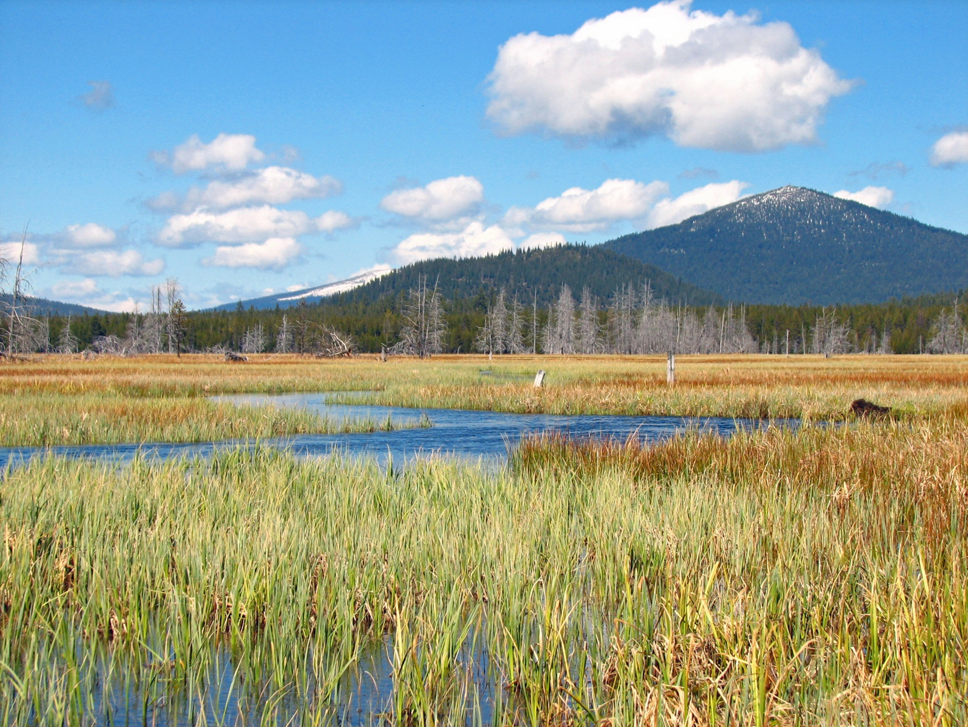
Group Exercise
Great Dismal Swamp:
Hydrological Restoration
The Marsh Project:
Prescribed Burning
Create a means-ends diagram for one of the examples using the given alternative and background materials
Notes:
Okay, now we will move into the group exercise.
You all received an email with background information on both of these examples. Hopefully you are sitting at a table that is labeled with the example you are more familiar or comfortable with.
The task is to work as a group to create a means-ends diagram for the alternative we’ve provided – for Great Dismal, it is hydrological restoration and for the Marsh it is prescribed burning.
Each table has a packet of information that we’ve summarized for you and also a copy of the case example that is in the guidebook for each one. This should give you enough information to go on. We’ve also outlined some steps to help you get started. There are flip charts and sharpies, or you can work on a computer if you would rather.
For Great Dismal, the ecosystem services are given in the documentation.
For the Marsh, the services are described in terms of priority benefits – which you will need to “translate” into services. The background packet has an example.
Dean, Lydia, and I will be available to answer questions. I can help with either – Dean is more familiar with the Marsh example and Lydia with Great Dismal.
We’ve got about 40 minutes for this exercise and then 20 for discussion. We’ll probably ask one group from each example to report back on the diagram you were able to create.

Slide 29
Notes:
For more information using means-ends diagrams during ecosystem services assessments, please visit nespguidebook.com. For more information about this project, contact Lydia Olander, Director of the National Ecosystem Services Partnership.

