Slide 1

The Federal Resource Management and Ecosystem Services Guidebook
ECONOMIC (MONETARY) VALUATION
ACES Workshop 2014
Robert J. Johnston, PhD
Professor of Economics
Department of Economics
Director and Research Professor
The George Perkins Marsh Institute
Clark University
Notes:
This presentation is one of a series given at an ACES workshop, December 8 2014 titled “Methods for Incorporating Ecosystem Services into Planning and Decision-Making” led by Lydia Olander (Nicholas Institute for Environmental Policy Solutions at Duke University and National Ecosystem Services Partnership) and Dean Urban (Nicholas School of the Environment at Duke University). This workshop discussed methods for conducting ecosystem services assessments as detailed in the Federal Resource Management and Ecosystem Services Guidebook. This presentation was created and presented by Robert J. Johnston and focuses on monetary valuation of ecosystem services.

Slide 2
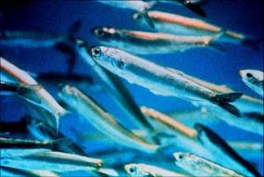

Integrating Social Value Through Economic Valuation
Quantifying the Economic Value of Ecosystem Services
Robert J. Johnston
Clark University
Methods for Incorporating Ecosystem Services into Planning and Decision-Making. ACES 2014 All-Day Workshop. A Community on Ecosystem Services: Linking Science, Practice and Decision-Making. Washington, DC, December 7-12

Slide 3
Ecosystem Service Values
Natural ecosystems provide goods and services that improve quality of life.
Economic values provide a consistent means to quantify and compare these improvements.
  Economic values quantify changes in well-being.
Ecosystem services cannot (often) be purchased directly in markets.
But the theory underlying value estimation is the same as that applied to market goods. The same rules apply.

Slide 4
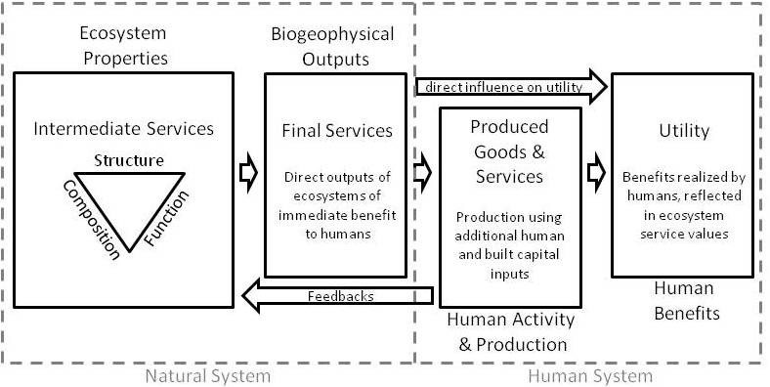
Conceptual Model of Ecosystem Service Values

Slide 5
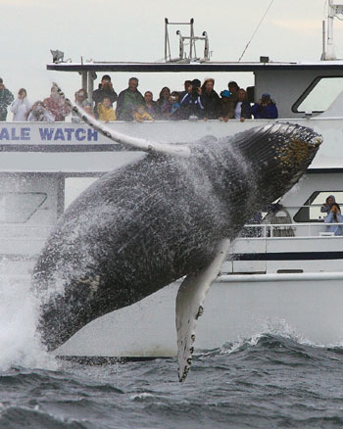
For something to have economic value…
It must be valued either directly or indirectly by humans, because it enhances quality of life
  NO: Whales value Stellwagen Bank as an important feeding area
  YES: Humans value Stellwagen
  Bank because it’s an important
  feeding ground for whales and
  we like to observe them there
  or just know that the ecosystem
  is healthy.

Slide 6
For something to have economic value…
It must be measured in terms of tradeoffs— what is the maximum one would be willing to give up in terms of
  other goods and services (I’ll would be willing to give up my sandwich for a chocolate bar)
  time (it takes an extra hour for me to travel to a better fishing site, but it’s worth it to me)
  money (I’m willing to pay $50 a night more for the room with the ocean view)
Values are often denominated in money terms, although this is not required.

Slide 7
For something to have economic value…
It must be measured in terms of a marginal quantity of a good or service, from a known baseline.
  NO: The total value of Narragansett Bay is $X.
  YES: The value of a 5% increase in clam harvest in Narragansett Bay, from the current level, would be $Y.
Example—it is possible, in principle, to estimate the economic value of an additional X acres of coastal wetland in a specific area.
  It is not possible to estimate the value of all wetlands in the world.

Slide 8
Willingness to Pay
Economists often measure economic value of ecosystems in terms of willingness to pay (WTP)
This is a theoretical concept: Defined as the maximum amount of money or some other good a person would be willing to give up in exchange for a good or service, rather than go without.
What’s the most a person would pay for a marginal change in an ecosystem service, rather than go without?
WTP does not always imply contingent valuation!

Slide 9
Types of Ecosystem Service Values
Total Value
Market
Non-Market
Market
Use
Non-Use
Consumptive
Non-Consumptive
Existence
Bequest
Altruistic

Slide 10
Quantifying Ecosystem Service Value
Requires coordination of ecological methods that quantify the “production” of services with economic methods that quantify value.
Ecosystem service values are often realized by multiple beneficiaries and through multiple channels.
Different methods are required to measure different types of value.

Slide 11
Common Valuation Methods
Revealed Preference (Use Value)—Quantify values based on observed behavior in or out of markets
  Recreation Demand Models
  Hedonic Property Value or Wage Methods
  Ecological Productivity Methods
  Defensive Behavior Methods
  Factor Input Methods
  Related Market Behavior
Stated Preference (Use + Nonuse Value)—Quantify values based on responses to carefully designed surveys
  Contingent Valuation
  Choice Experiments
Benefit Transfer—Use results from a study elsewhere to quantify values for a site where no results are available

Slide 12
Example—Factor Inputs
(Value to Producers)
Consider a market product produced with an ecosystem service as an input (e.g., shrimp). Producer value is the difference between revenue and cost for each unit sold.
$
Marginal Cost
(also Supply)
Price
Demand
Surplus to producer for
this unit of production
QUANTITY

Slide 13
Ecosystem Service Change Affects the Cost of Production
Example: Habitat restoration increases shrimp abundance and decreases the marginal cost of harvest.
PR
I
C
E
Demand
QUANTITY

Slide 14
Measuring Value Changes—
A Spreadsheet Example
Degraded Habitat
Improved Habitat
Catch rate per day = 5,000 lbs.
Dockside Price = $0.70
Variable cost per pound = $0.50
Total days fished in season = 16
Total revenue = 16 x 5,000 x $0.70 = $56,000
Total variable costs = 16 x 5,000 x $0.50 = $40,000
Producer Surplus = $56,000 - $40,000 = $16,000
Catch rate per day = 8,000 lbs.
Dockside Price = $0.70
Variable cost per pound = $0.40
Total days fished in season = 16
Total revenue = 16 x 8,000 x $0.70 = $89,600
Total variable costs = 16 x 8,000 x $0.40 = $51,200
Producer Surplus = $89,600 - $51,200 = $38,400
Change in Ecosystem Service Value to Shrimp Harvesters = $22,400 / yr.
Additional values may be realized by consumers if prices change.

Slide 15
Another Example: Recreation Demand & Value
Cost $A
Catch Rate A
Choices reveal values and tradeoffs
A
Cost $D
Catch Rate D
Cost $B
Catch Rate B
D
B
C
Cost $C
Catch Rate C

Slide 16
Ecosystem Services, Water Quality & Recreational Fishing Values
Riparian Land Change
Water Quality Change
Catch Rate Change
Random Utility Model
Value Change

Slide 17
Expected Catch Rate is a Function of Ecosystem Condition (Lipton 2005)
Variable Coefficient t-test
Constant -5.897 -6.592*
Historic catch rate 0.631 11.396*
LN(Hours) 0.344 3.337*
Years Fished 0.019 6.073*
Days Fished (12) 0.001 1.474
Surface Temp -0.255 -2.596*
Bottom Temp 0.323 2.838*
Surface Oxygen 0.259 4.414*
Bottom Oxygen 0.225 1.953*
Oxygen² -0.017 -2.023*
Site choice and recreational values then depend on expected catch rates.

Slide 18
Illustrative Values From Chesapeake Bay Striped Bass Choice Model, 5% Discount Rate
Reduced Water Quality (DO) diminishes catch rates, and leads to reduced recreational values:
  <= 5 mg/l -$ 98.5 Million
  <= 4 mg/l -$122.9 Million
  <= 3 mg/l -$145.3 Million
(Lipton 2005)

Slide 19
Applicable Methods Depend on the Values to be Measured
Benefit Transfer versus Primary Studies
The source and quality of economic insight is critical.
Economic data and results may be drawn from either primary research, benefit transfer, or a combination.
  Primary research – original data collection and model development.
  Benefit transfer – Use of results from prior primary research to predict results for unstudied policy sites.
Benefit transfer is lower cost but can yield large errors.
Errors depend on a variety of factors, including the type of transfer.
Estimation of the total value of an ecosystem service change often requires estimates from multiple different valuation models.
Values also differ across time, space and beneficiary groups.
Values from valuation studies cannot generally be “scaled-up” to generate values for much larger changes or areas.

Slide 20
Applicable Transfer Methods Depend on Needs, Resources and Policy Context
Unit Value Transfer (transfer a number)—Simple but risks large error if study and policy sites are not very similar.
Benefit Function Transfer (transfer a function from one study)—Allows adjustments for some differences between study and policy sites, but accuracy depends on site similarity.
Meta-Analysis (transfer a function calculated from the results of many studies)—Most flexible approach and does not require site-to-site similarity, but can be sensitive to statistical methods.

Slide 21
An Example: Meta-Analysis Benefit Transfer
Results of Stapler and Johnston (2009) show how transfers can account for value differences across service types (e.g., types of fish).
Mean Predicted Marginal Value per Fish, by Region and Species
Species | California | North Atlantic | Mid-Atlantic | South Atlantic | Gulf of Mexico | Great Lakes | Inland
big game | $12.32 | $6.19 | $5.95 | $13.57 | $13.26
small game | $6.38 | $5.22 | $5.19 | $5.03 | $4.95 |  | $4.71
flatfish | $8.57 | $5.24 | $4.94 | $4.93 | $4.82
other saltwater | $2.60 | $2.62 | $2.56 | $2.50 | $2.44 |  | $2.54
salmon | $13.67 |  |  |  |  | $11.66 | $13.88
steelhead | $11.25 |  |  |  |  | $12.57 | $11.42
musky |  |  |  |  |  | $61.37 | $64.71
walleye/pike |  |  |  |  |  | $3.61 | $3.60
bass |  |  |  |  |  | $7.52 | $7.92
panfish |  |  | $0.93 | $0.93 |  | $1.17 | $0.93
rainbow trout |  |  |  |  |  | $7.38 | $2.84
other trout |  |  |  |  |  | $8.29 | $2.48
generic freshwater |  |  |  |  |  | $5.46 | $1.96
generic saltwater | $2.73 | $2.64 | $2.85 | $2.51 | $3.22 |  | $2.79

Slide 22
Common Errors
Measuring the “total value” of large ecosystems.
Scaling-up results from small scale studies, or transferring “values per hectare.”
Using replacement or damage costs to measure values.
Using economic impacts such as jobs and revenues to measure values.
Double counting (confusing intermediate and final services).
Using cost- or donor-based methods such as EMERGY (confusing costs and benefits).

Slide 23
Summary
Frameworks and methods for ecosystem service valuation are well-developed.
Economic values relate to choices, tradeoffs and social welfare – not economic activity alone.
No one method can serve all valuation purposes.
It is important to be aware of what is being measured by each method.
Just because a “value” is measured in dollars does not mean it is a valid measure of ecosystem service value—caveat emptor.

Slide 24
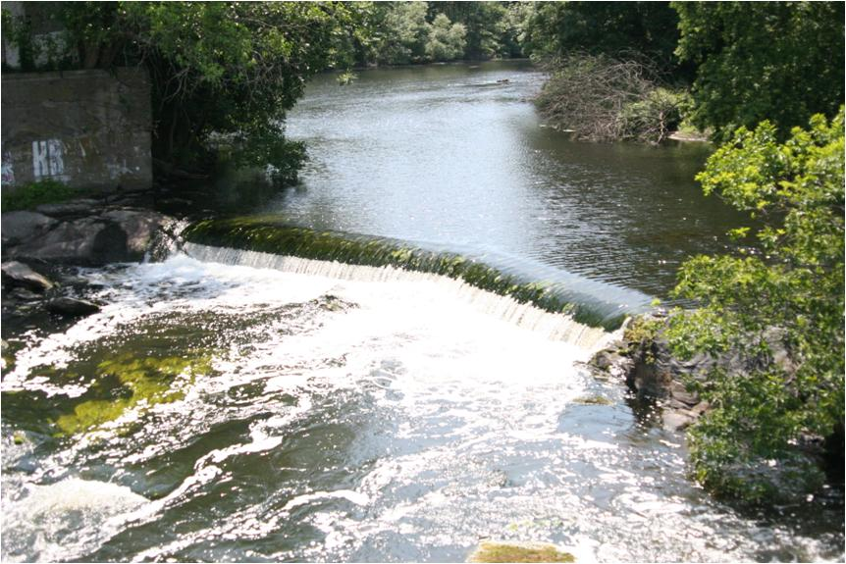
Questions?
Robert J. Johnston
Director, George Perkins Marsh Institute
Professor, Department of Economics
Clark University
950 Main St.
Worcester, MA 01610
Phone: (508) 751-4619
Email: rjohnston@clarku.edu

Slide 25
Notes:
For more information on monetary valuation of ecosystem services, please visit nespguidebook.com. For more information about this project, contact Lydia Olander, Director of the National Ecosystem Services Partnership.

